Slide 1
WC DISASTER Management Drought assessment KANNALAND MUNICIPALITY
DATE: | 17 May 2018
PRESENTER: | Kannaland Municipality

Slide 2
Index
Drought Situation
Water Consumers – Top 5 Industries
Drought Augmentation Projects
Short – Medium Term Project
Hazard Frequency
Disaster Management Readiness
Conclusion

Slide 3
DROUGHT SITUATION
Ladismith
La Grange dam 0%
Goewerments dam 0%
Gholf course dam 0%
11 Boreholes operational
(1 Borehole in process to be repaired)
Demand: 4,1 Ml p.d
Supply: 4,5 Ml p.d (boreholes + river abstraction)
Surplus: 0,4 Ml p.d
Calitzdorp
Nelsdam 12%
Water supply sufficient to meet water demand storage capacity for three months
No alternative water resources, however a need for boreholes has been identified
Zoar
Tierkloof dam 80% = 16 days water availability
Jongenlandsdam
30% - Alternative resource
No alternative water resources, however a need for boreholes has been identified
2 Boreholes operational
(1 Borehole in process to be repaired)
“Die Oog” fountain supply water together with the boreholes
Water is currently sufficient for the town.
Van Wyksdorp
Notes:
11 boreholes operational – 40 liter per second /
Borehole Meeting – Cleansing of the meters
Rivier Water ontrekking en meting vir daaglikse gebruik –

Slide 4
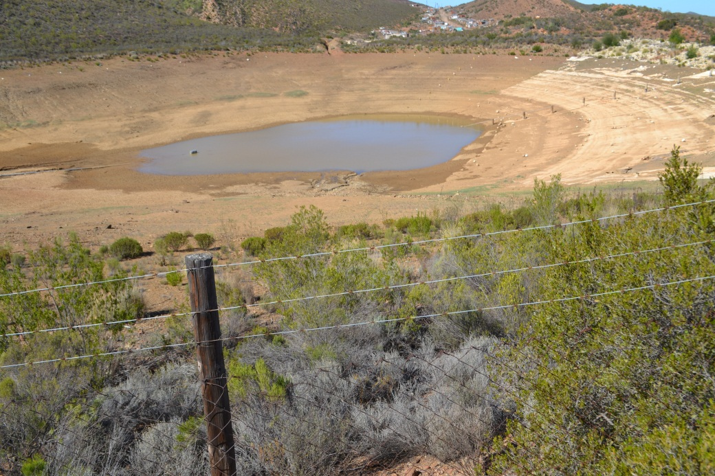
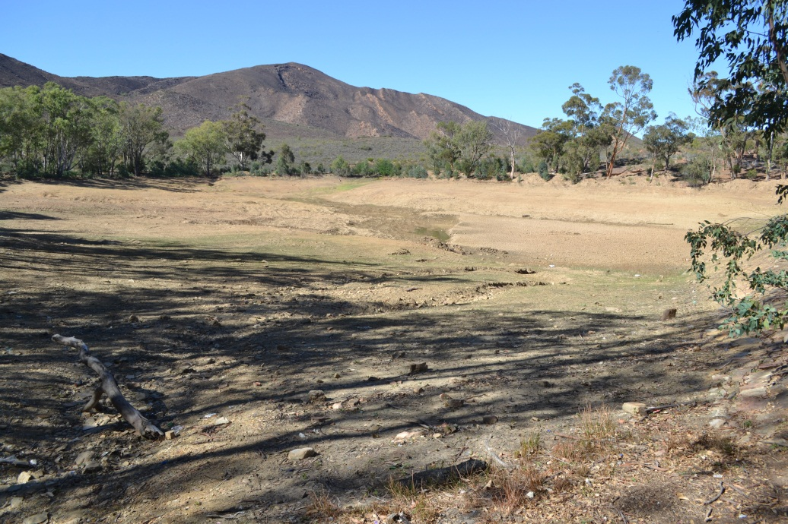
LADISMITH DAMS
La Grange Dam
Goewerments Dam

Slide 5
Top Water Consumers
INDUSTRIES - 23.6% | % OF AVERAGE WATER DEMAND
Parmalat (LDS) | 50.4%
Ladismith Cheese | 42.9%
Calitzdorp Boplaas Wyn Kelder | 0.7%
Suid-Kaap Wingerde | 5,3%
Ladismith Agri-mark | 0.7%
COMMERCIAL – 16.3% | % OF AVERAGE WATER DEMAND
Ladismith Correctional Services | 35.4%
Ladismith Secondary School | 25,4%
Huis Isak Van Tonder | 16%
Huis Langenhoven Ladismith | 11.2%
Vygies Hof - Calitzdorp | 12.9%

Slide 6
Top Water Consumers
DOMESTIC – 60.1% | % OF AVERAGE WATER DEMAND
Ladismith | 29%
Calitzdorp | 30,1%
Zoar | 38.7%
Van Wyksdorp | 2.2%

Slide 7
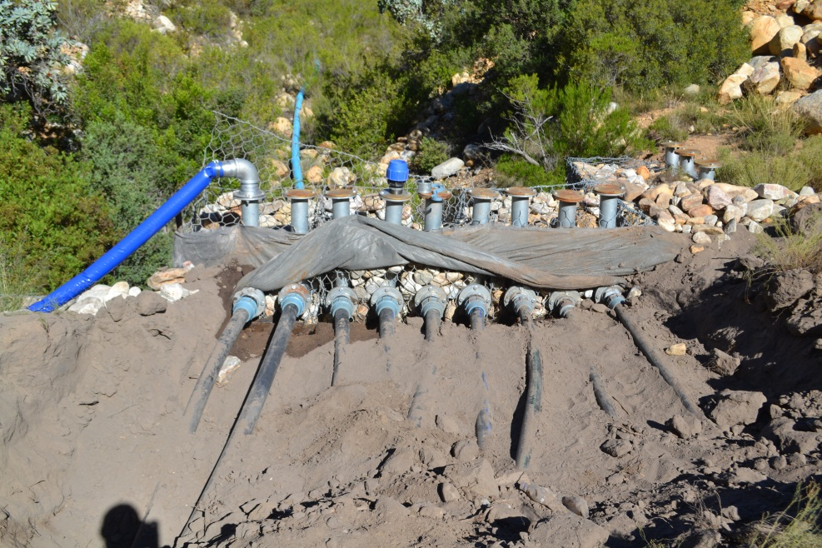
DROUGHT PROJECTS
LADISMITH
R3.8 million from DLG
Temporary relocation of the Swartberg River Diversion
Rehabilitation of the Raw water supply canal
Rehabilitation of the Infiltration drain
Clearing and Cleaning of Storage Dams
Upgrade Existing Groundwater Scheme
Back-up Booster pump installed
Notes:
Status wrt the project: Leon to give info

Slide 8
DROUGHT PROJECTS
ZOAR
R4 million from MIG funds
VAN WYKSDORP
Refurbishment of borehole pumps (Internal Funding)
Construction of a 1.0 Ml Reservoir at the Water Treatment Works (WTW)
Refurbishment of the WTW
Construction of a 63mm pipeline in Karoolande area
Installation of fire hydrants and cut-off valves
CALITZDORP
Existing borehole investigation
Drill of new borehole or equipment of existing borehole
Internal intervention with the water treatment plant (Completed)
Bloekomlaan Reservoir Repairs WSIG Funding
Refurbishment of raw water supply pipeline
Source Funding - Boreholes
Notes:
Status wrt the project: Leon to give info

Slide 9
DROUGHT PROJECTS
Water meter repair program – Update
Water meter audit and repairs – R1 mil from PT
Water restriction in all towns – (Levels)
Ladismith level 4, Calitzdorp level 4, Zoar level 3 and Van Wyksdorp level 3
Awareness campaigns launched
Contingency plan for day zero – Disaster Management
Notes:
Kent (SP) to repair the faulty meters
WOL to be form part of the program
All meters to be audited
Water restriction – Level 4
Enforcement of the restrictions are the main challenge (law enforcement officers)
4. Awareness should be rolled out in all four towns – Radio broadcasting, load hailing, GCIS, to alert everyone about the drought situation.

Slide 10
Short-Term Projects
Fast tracking of:
Buy and put in place Water Tanks at:
Schools, Clinics, Old Age Homes, Police Stations
Emergency Services
Municipal buildings and facilities (Collection Points)
Investigate the installation of pressure reduction valves in pipelines
Peer learning project: Saldanha Municipality
Decrease water losses: Beaufort West Municipality
Adhoc Water Monsters for quality: Eden District Municipality
Weekly updates on water availability: Flash News
Removal of invasive alien plants and trees

Slide 11
Medium to Long-Term Projects
Fast tracking of:
The Swartberg Dam in Ladismith: R330mil (Mayor to draft letter to Minister)
The upgrading of the Waste Water Treatment Works: R110mil
Construction of a Reservoir in Bloekomlaan –Calitzdorp: R8mil
Construction of a high pressure reservoir Calitzdorp Bergsig: R10mil
Upgrading of the water reticulation in Ladismith , Van Wyksdorp: R15mil
Upgrading of the raw water supply pipeline in Calitzdorp: R14.5mil
Klein Karoo Rural Water Scheme (KKRWS) takeover

Slide 12
Medium to Long-Term Projects
Fast tracking of:
Investigating and drilling of more boreholes
Ladismith 3 = 15 Litre per second
Zoar 2 = 10 Litre per second
Calitzdorp 3 =15 Litre per second
Installing of Early Warning Systems

Slide 13
Hazard Frequency
The current year Kannaland has experienced serious shortfalls as a result of the severe drought in the Kannaland LM
Both residents and farmers, in all towns have raised significant concerns
Water supply was reached at a critical level but is currently being address through short-term and long-term interventions
Disaster Management structure were activated to be pro-active before disasters occur

Slide 14
Disaster Management Readiness
Kannaland local disaster management committee in place and engage on regular basis.
Identification and Installation of water tanks at strategic distribution points
Water will be shut down to regulate water flows
50 litre drinking water per household per day will be supplied at distribution points.
Transport of water
Stock pile water at distribution points
Communication – radio broadcasting, pamphleteering and loud hailing (Regularly), bulk sms’
Activation of contingency plans from Emergency services, SAPS, Ambulance Service and hospital and Clinics for outbreaks of any diseases

Slide 15
CONCLUSION
Socio & Economic Growth
Storage Capacity
Water Security
New Swartberg Dam Ladismith
COST = R330mil.

Slide 16
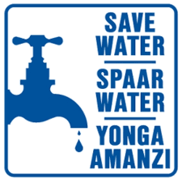
CONCLUSION

Slide 17
Thank You Dankie Enkosi

